Slide 1

Churn Analysis and Segmentation Subscription Services

Slide 2
Churn Analysis
Important component of a company's customer retention tactics
Combining cluster modeling and churn research to better understand various client categories
Identify distinct groups of customers based on their characteristics and behaviors

Slide 3
Insights to Achieve
Customer Segmentation: Divide consumers into groups based on shared features - distinct tastes, habits, and demands by evaluating the clusters
Churn Patterns: Each cluster reveals patterns and trends unique to each client category
Churn Drivers: uncover elements that lead to churn
To tailor retension Strategies
Customer Lifetime value

Slide 4
Dataset Description
Anonymized data on client subscriptions,
payment methods
viewing preferences
customer support interactions
https://www.kaggle.com/datasets/safrin03/predictive-analytics-for-customer-churn-dataset?select=test.csv
4

Slide 5
Dataset Statistics
 | Count
Churn | 44,182
Non Churn | 199,605
Total | 243,787
5

Slide 6
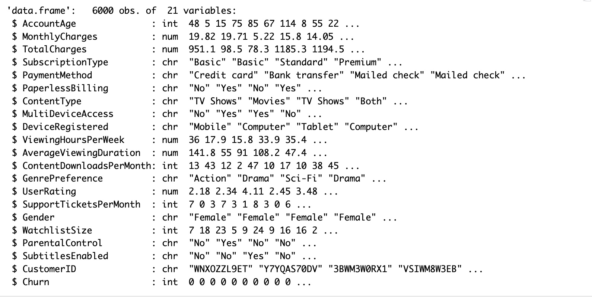
Dataset Variables

Slide 7
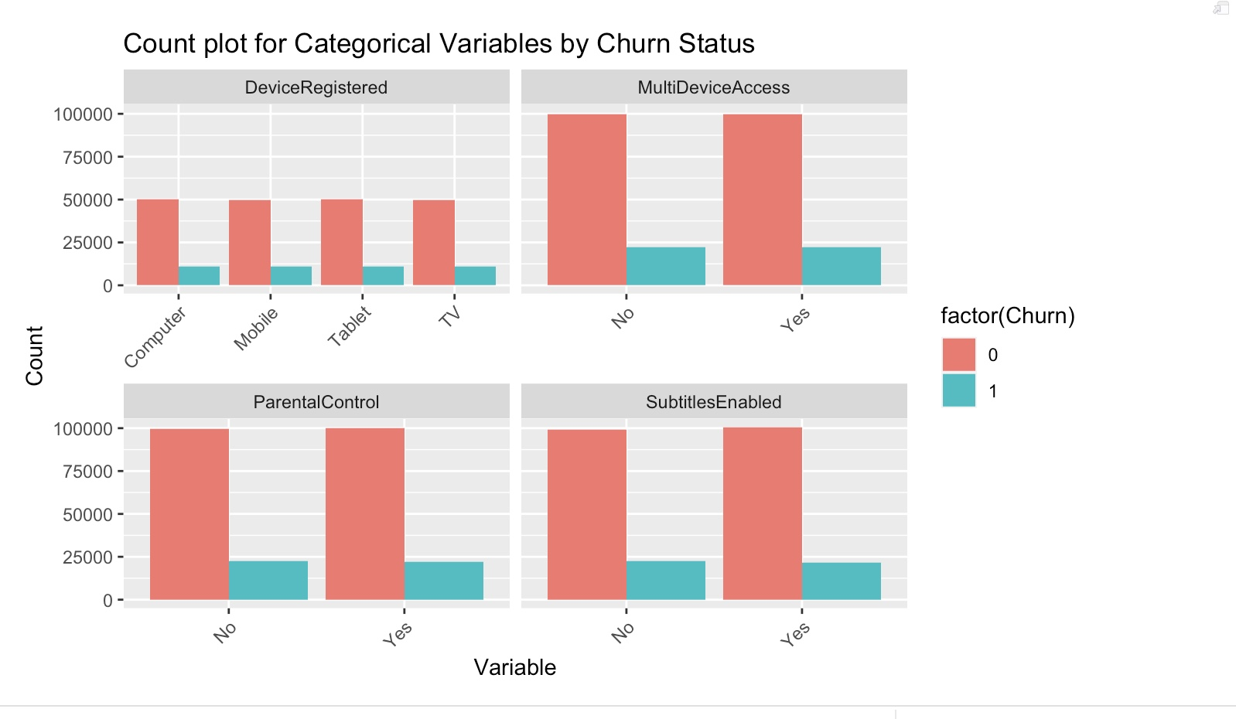
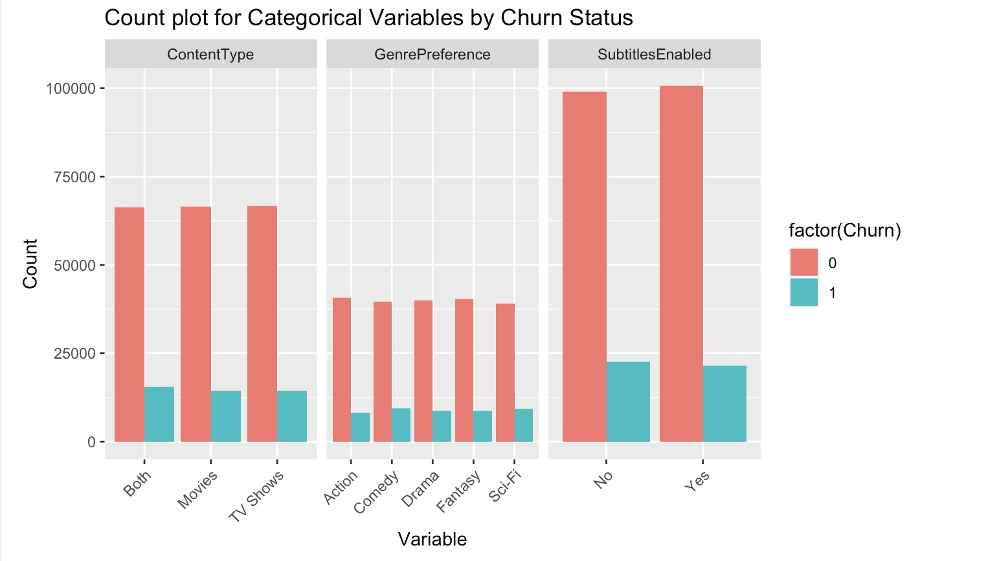
Dataset Statistics

Slide 8
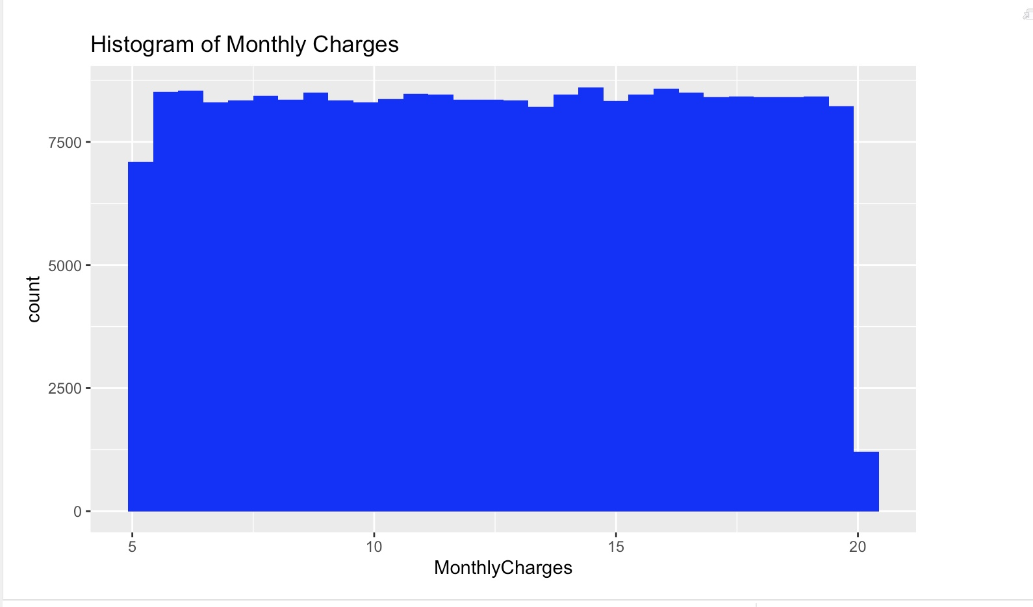
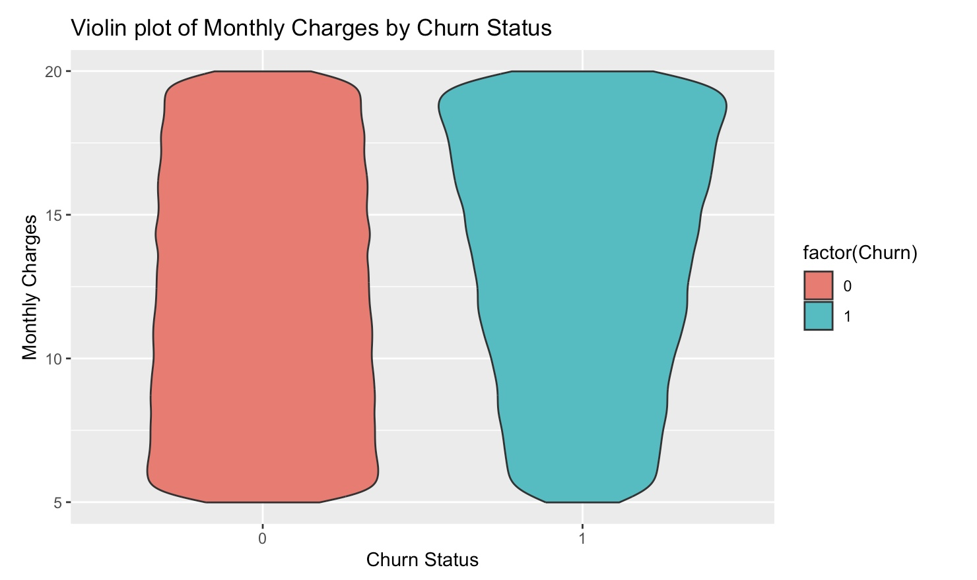
Dataset Statistics

Slide 9
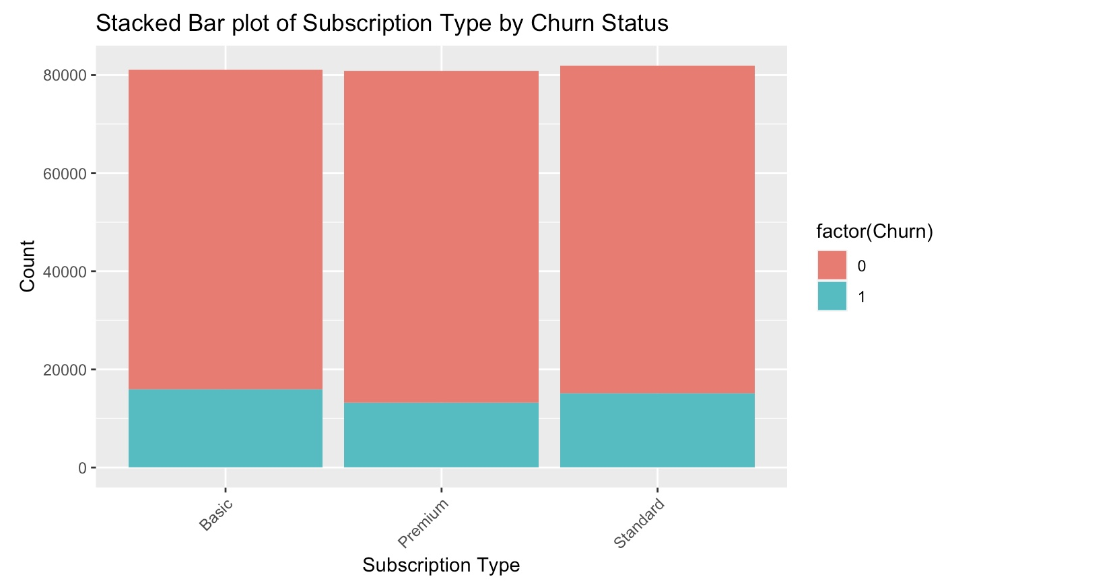
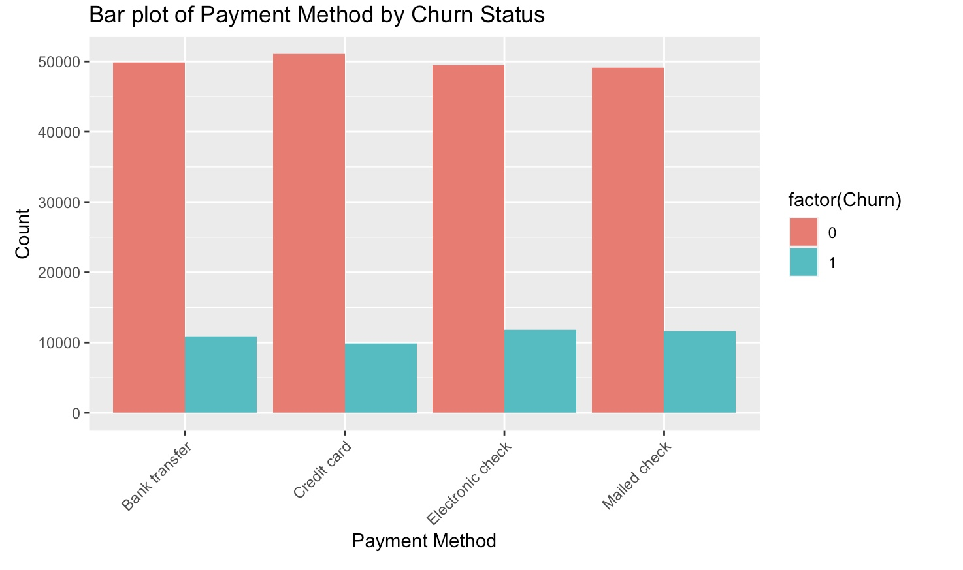
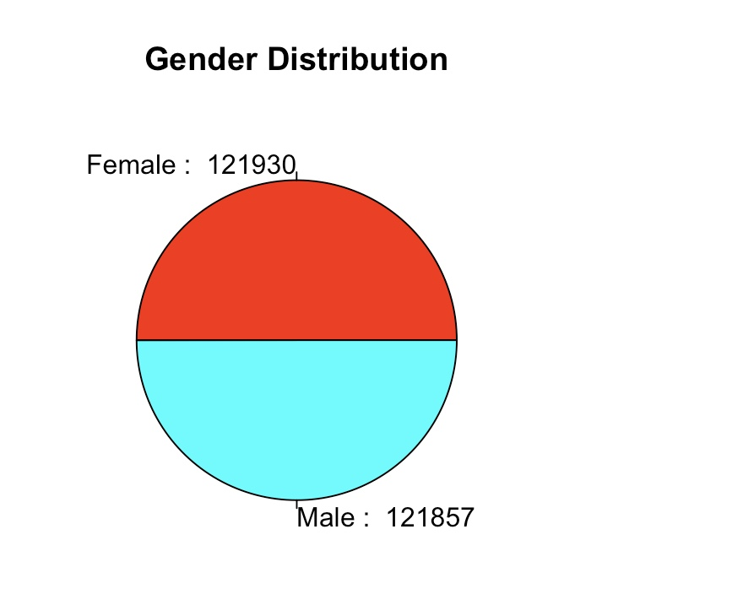
Dataset Statistics

Slide 10
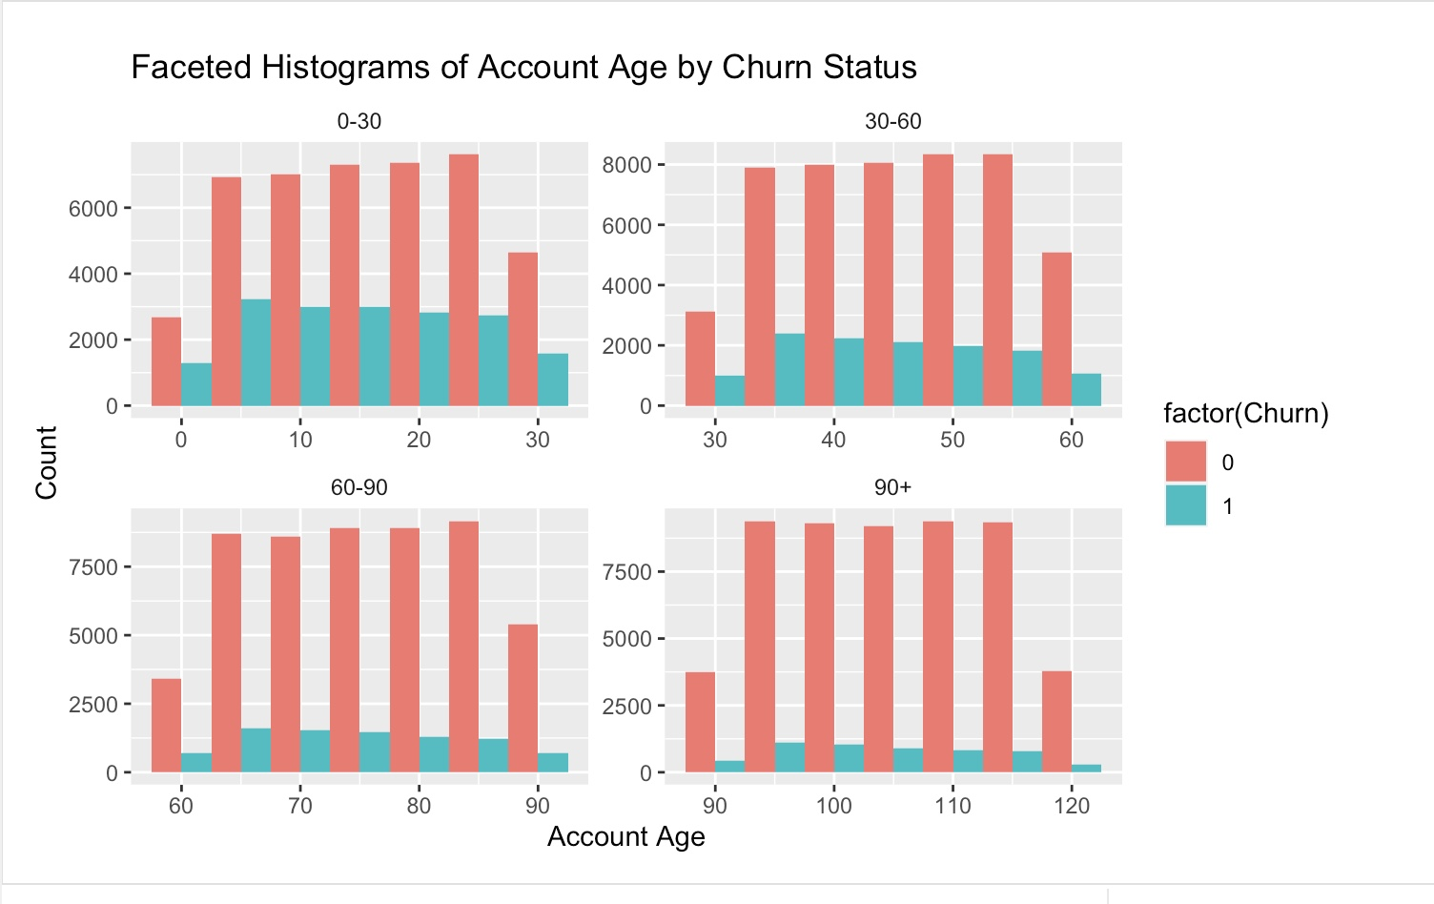
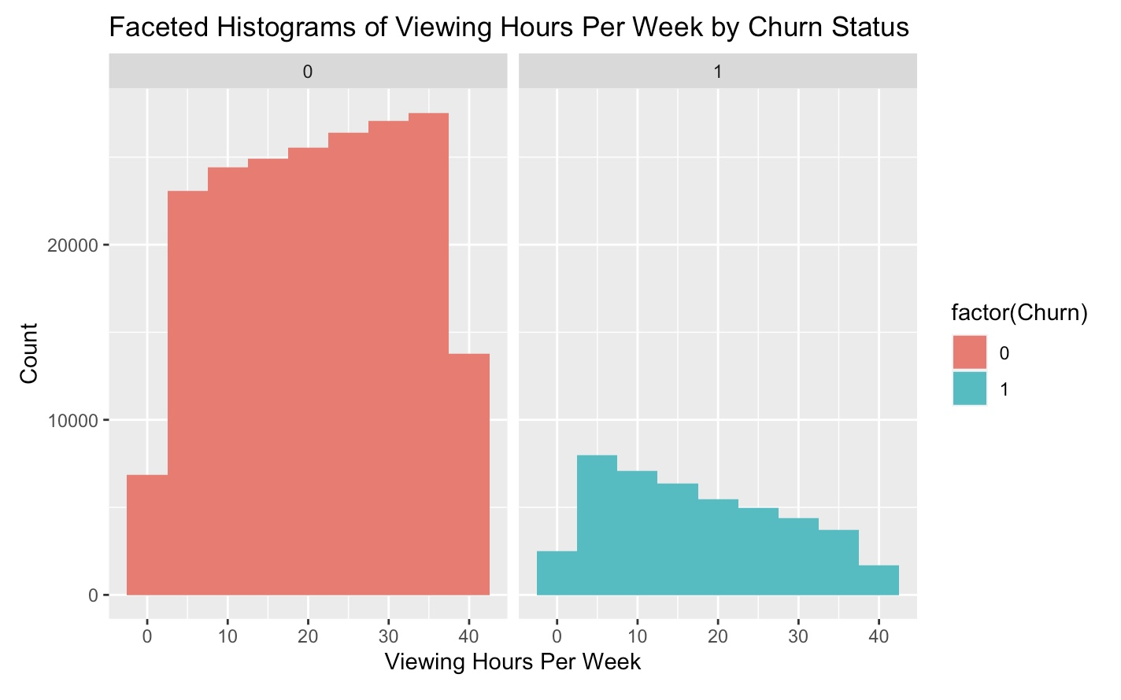
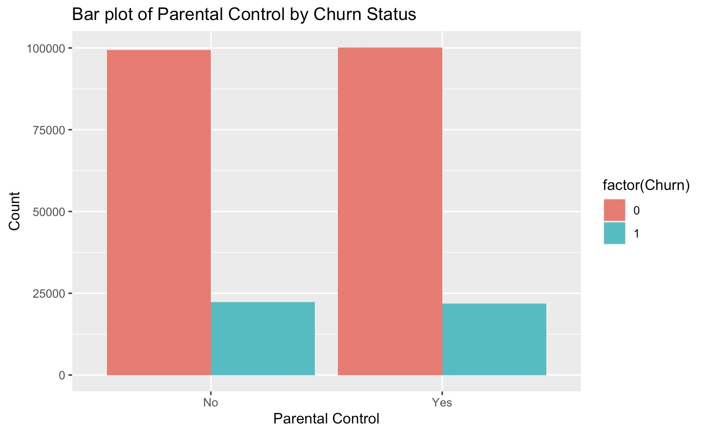
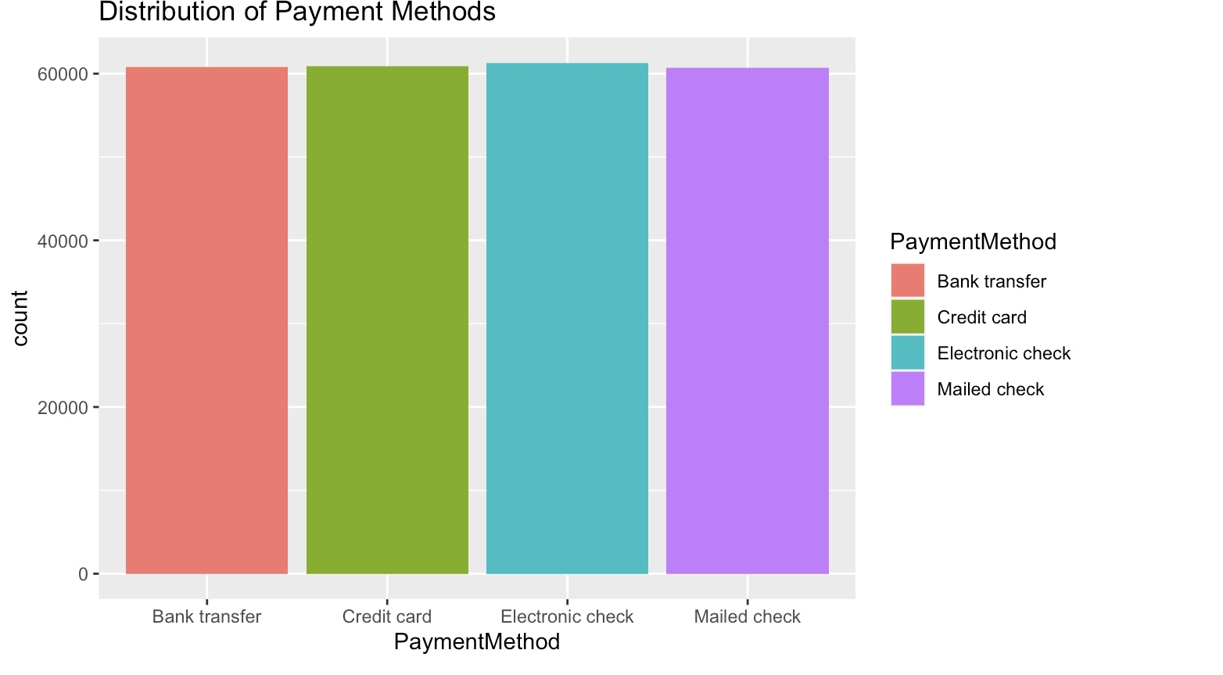
Dataset Statistics

Slide 11
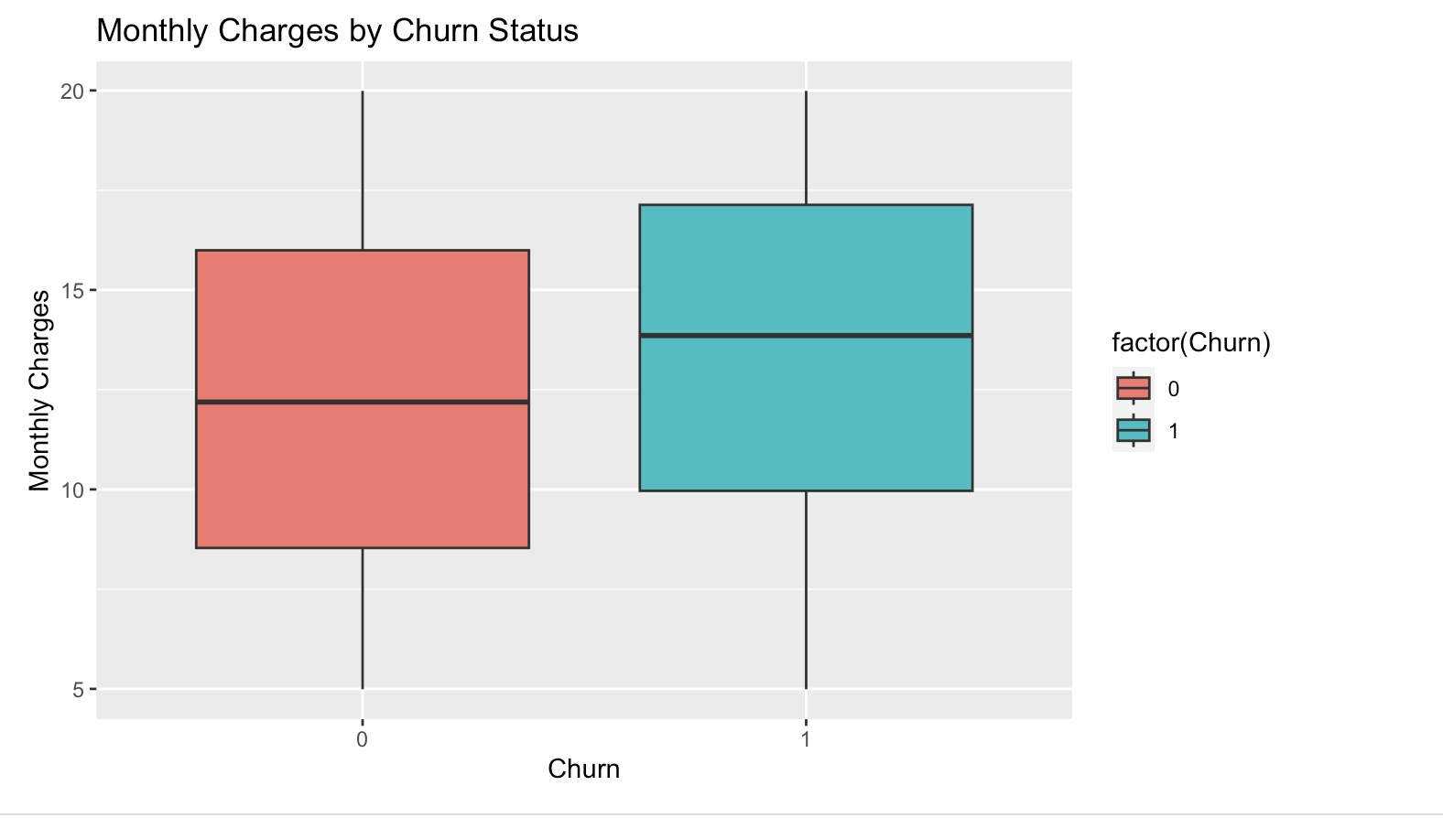
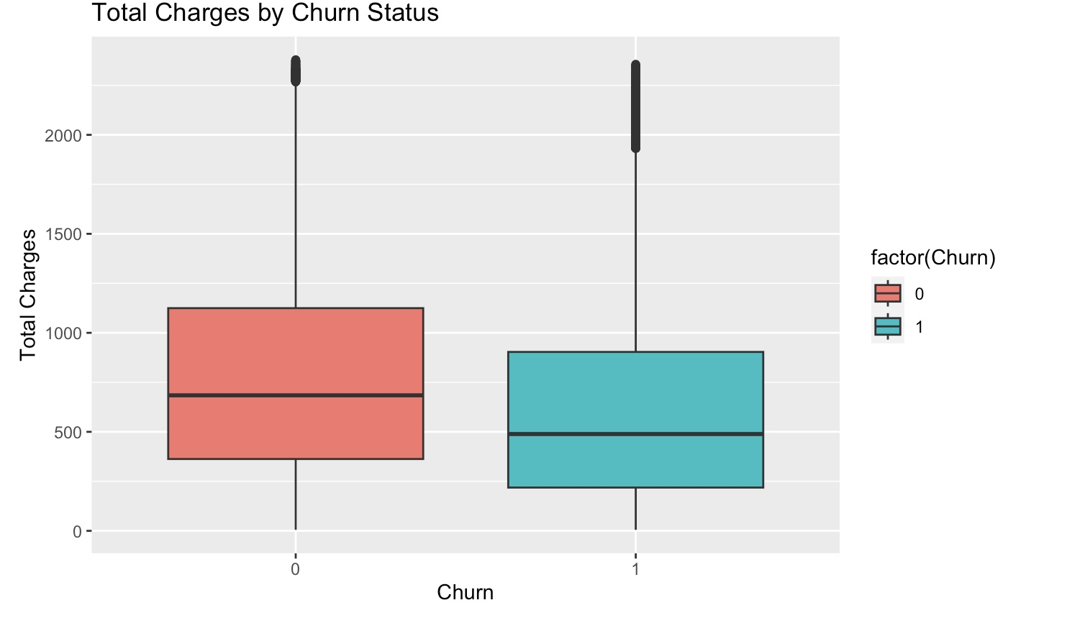
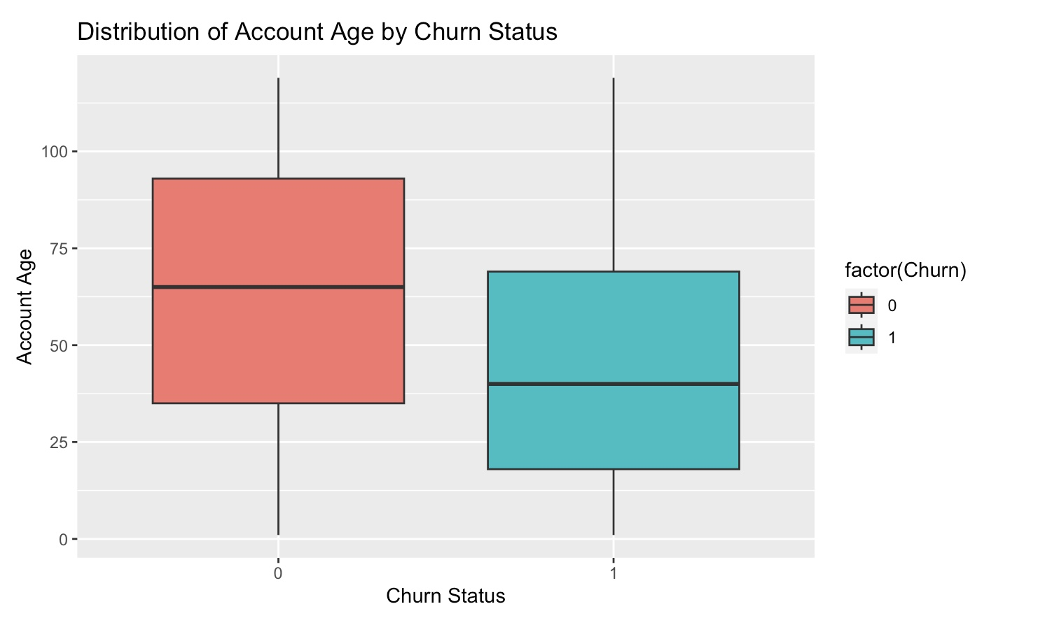
Dataset Statistics

Slide 12
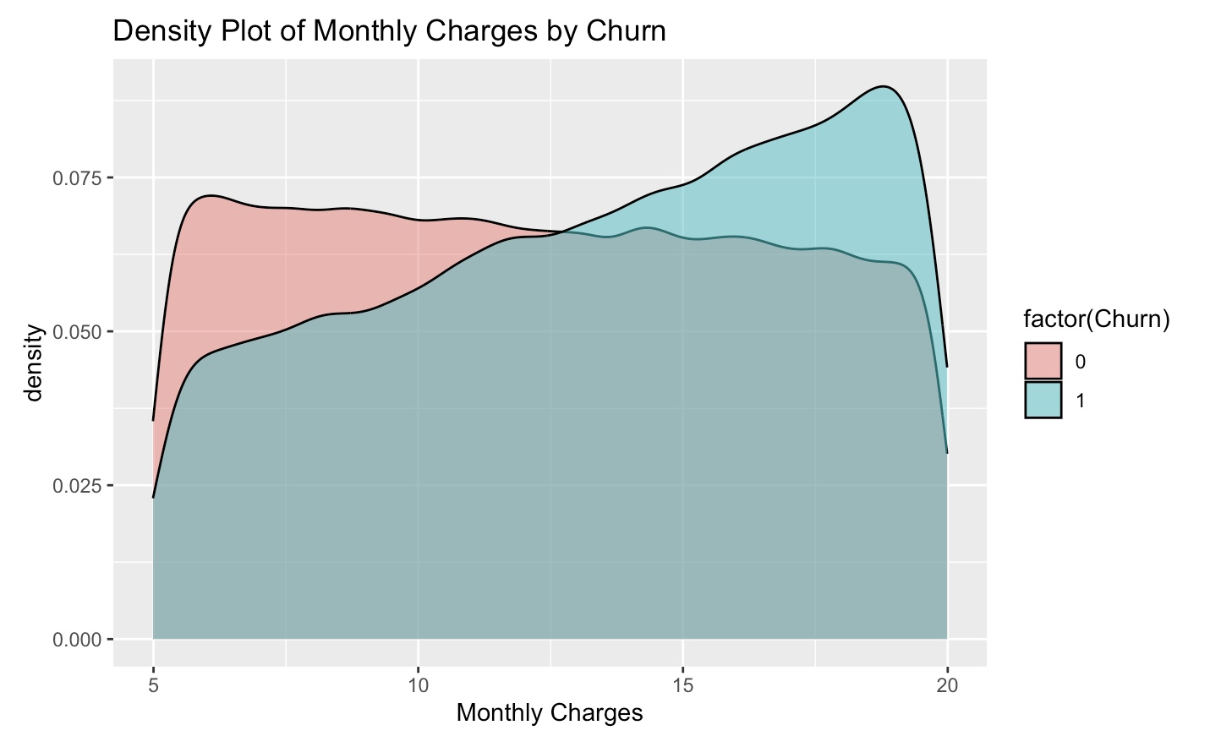
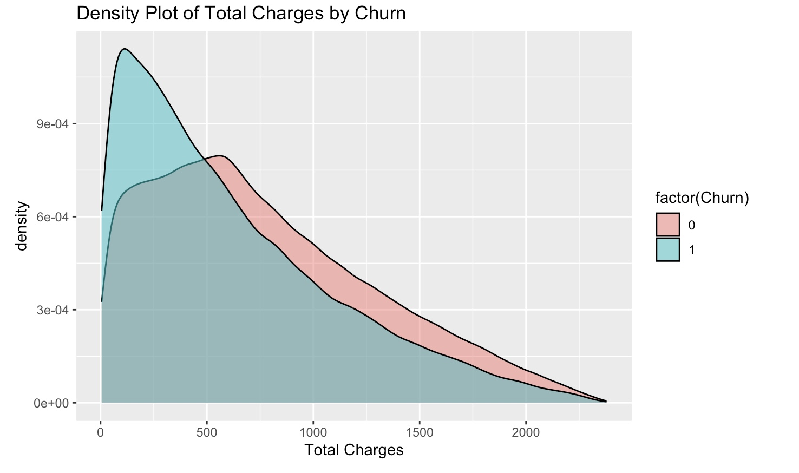
Dataset Statistics

Slide 13
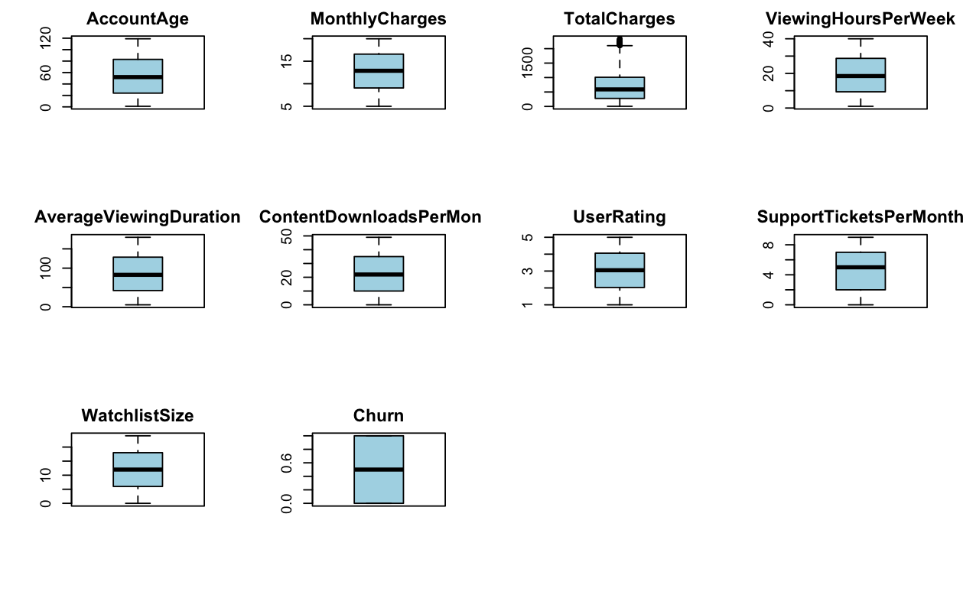

Slide 14
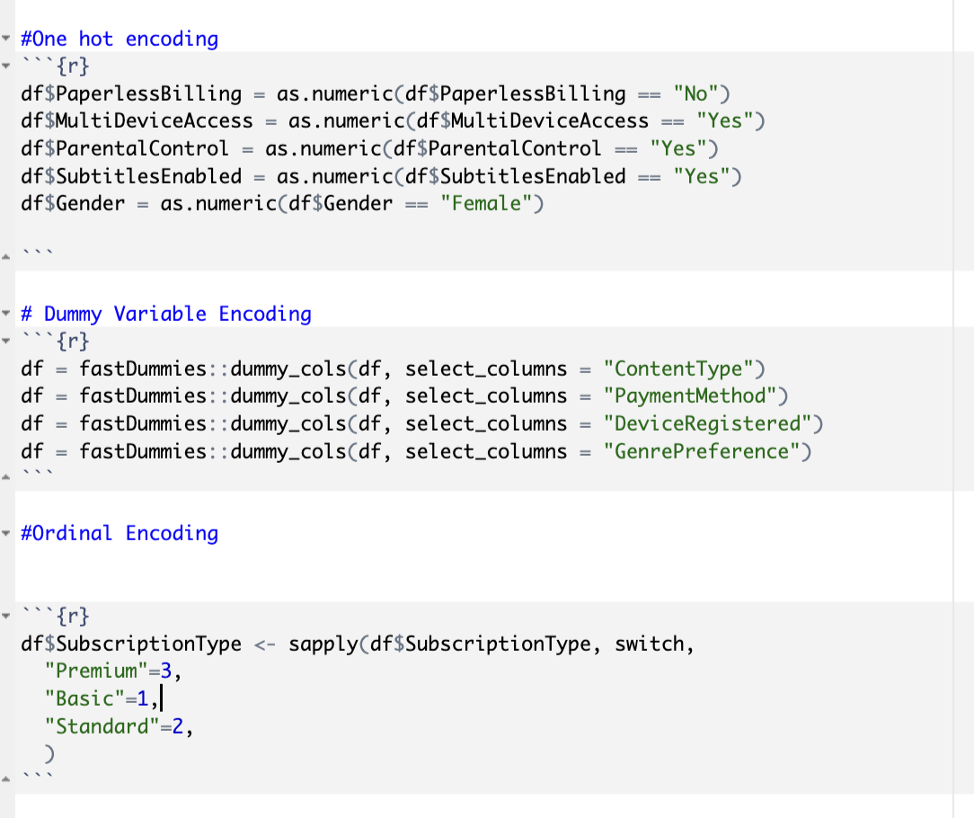
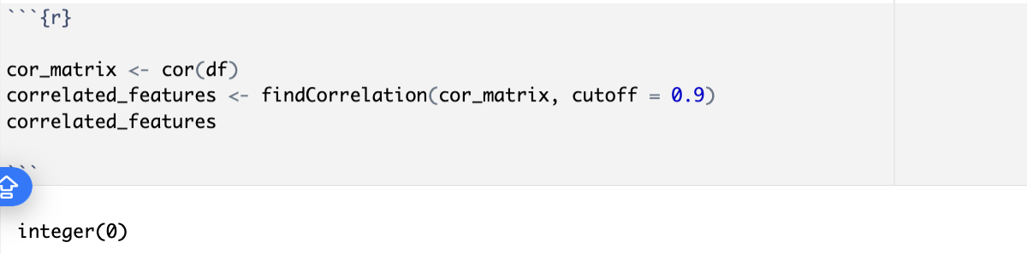
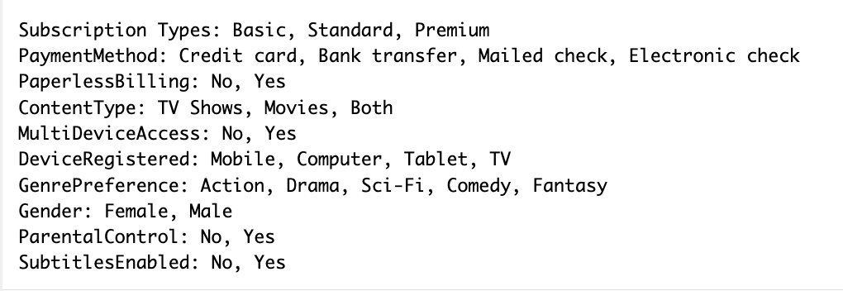
Data Preprocessing

Slide 15
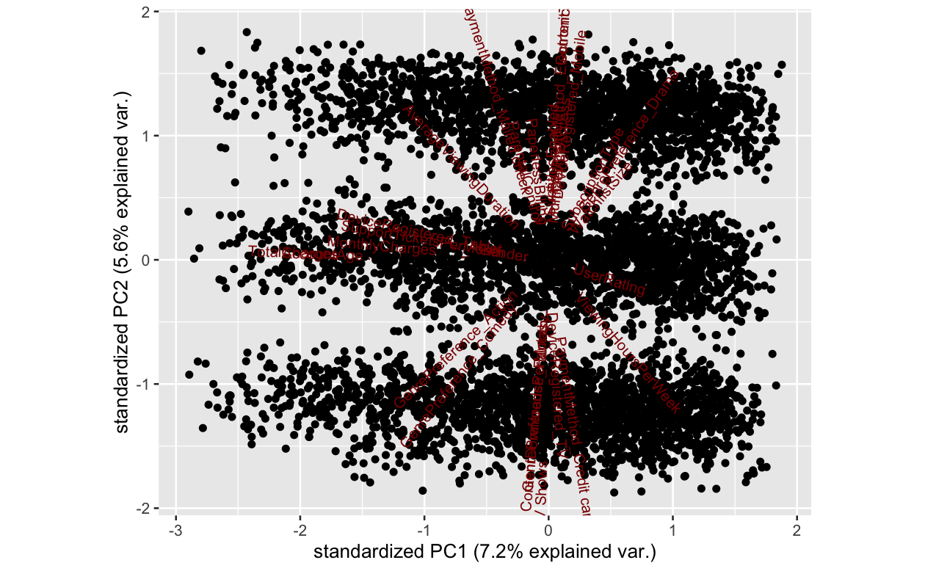
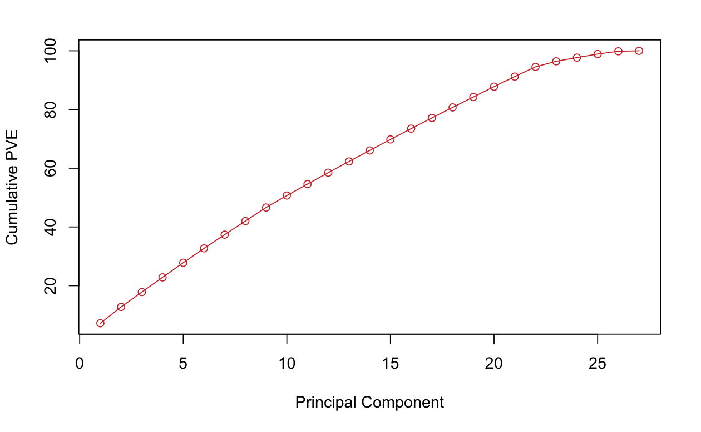
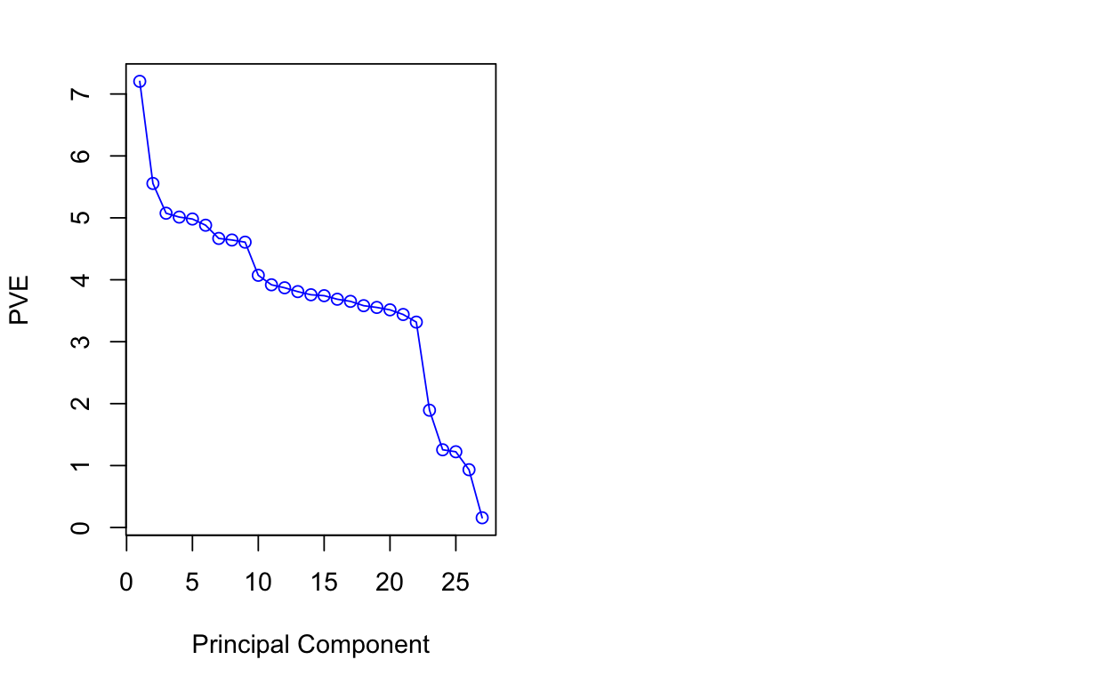
Data Preprocessing - PCA

Slide 16
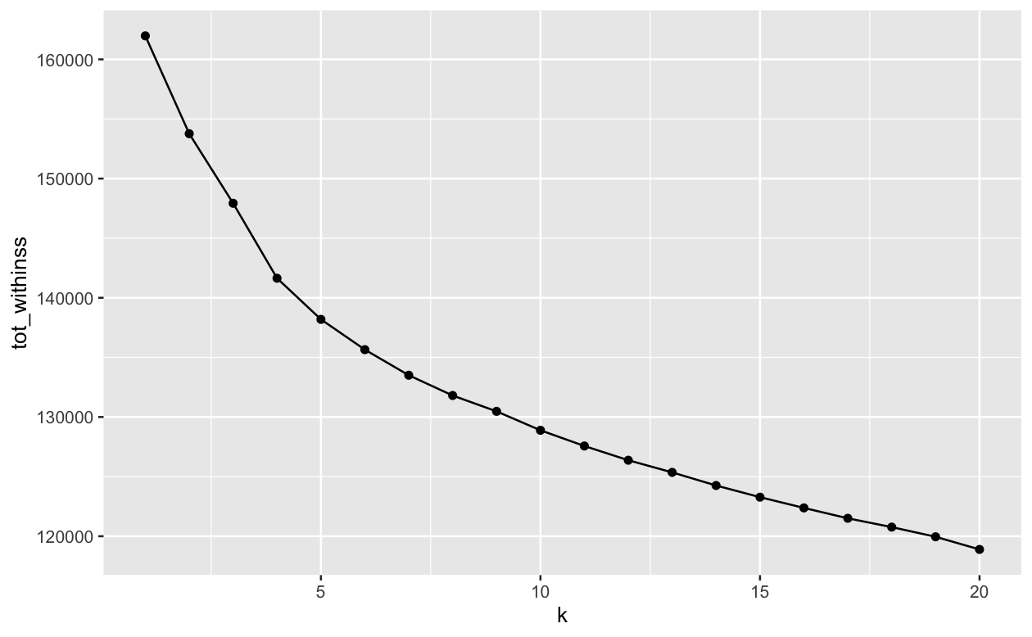
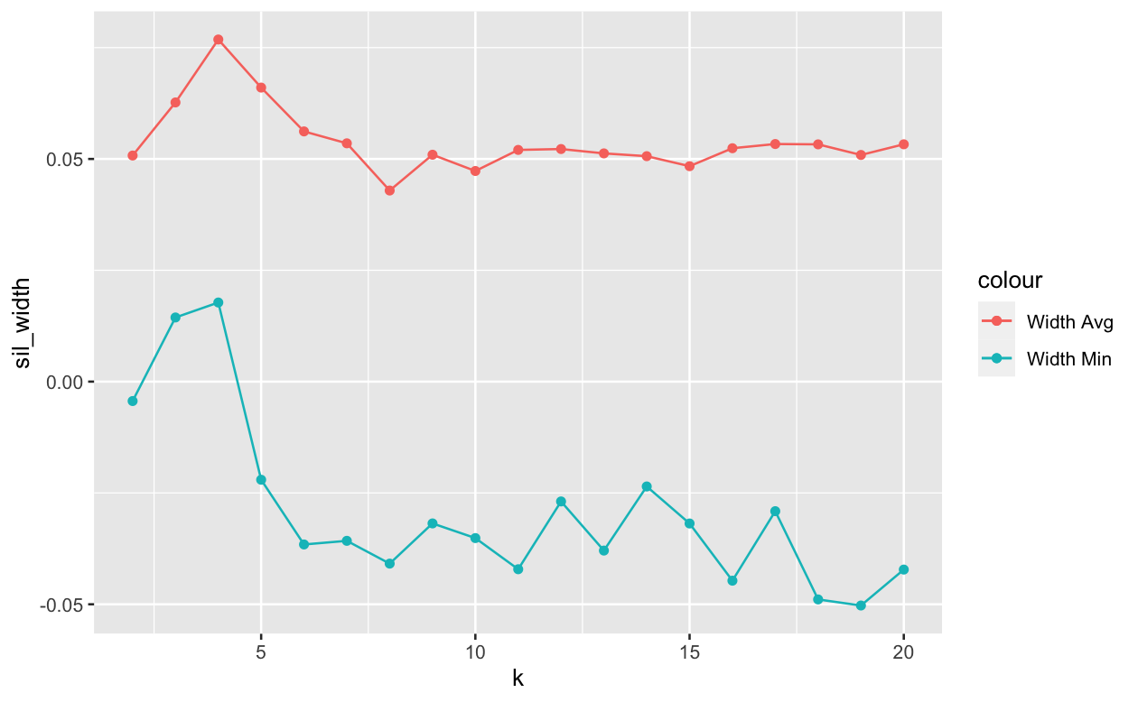
Kmeans Clustering
ELBOW METHOD
SILHOUETTE

Slide 17
GMM Clustering – Optimal Clusters GMM
Introduction:
Gaussian Mixture Model (GMM) is a probabilistic model that represents a mixture of multiple Gaussian distributions.
GMM clustering is a versatile technique used for identifying patterns and structure within complex datasets.
Objective of Optimal Clusters:
The determination of the optimal number of clusters is a critical step in GMM clustering.
Optimal clusters represent the most meaningful and interpretable partitioning of the data.
Methods for Identifying Optimal Clusters
Elbow Method
Silhouette Score
BIC (Bayesian Information Criterion).
Challenges in Determining Optimal Clusters:
Selecting the optimal number of clusters is not always straightforward and depends on the characteristics of the data.
Different methods may yield different results, and a comprehensive evaluation is often required.
Application to GMM Clustering:
In GMM clustering, the optimal number of clusters is crucial for accurate representation and interpretation of underlying data structures.
Different numbers of clusters can lead to varied insights, and the choice should align with the research goals.
Visual Representation:
Visual aids, such as elbow plots or silhouette plots, can be effective in illustrating the rationale behind the selection of the optimal number of clusters.
Impact on Analysis:
The choice of optimal clusters influences subsequent analyses and interpretations, affecting the granularity of insights derived from the GMM clustering.

Slide 18
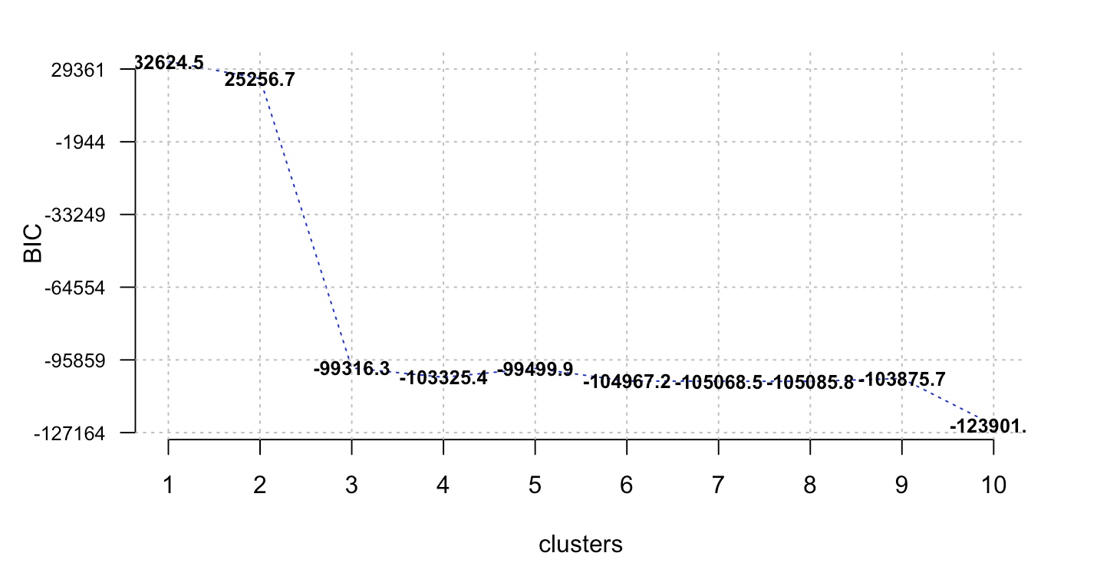

Slide 19
LPA Vs. LCA
Objective:
LCA: Primarily focuses on identifying latent classes or categorical groups within a population based on observed variables.
LPA: Aims to identify latent profiles that may include both categorical and continuous variables, providing a more flexible approach.
Nature of Groups:
LCA: Defines homogeneous classes within a population, where individuals within a class share similar response patterns.
LPA: Defines profiles that can include both categorical and continuous variables, allowing for a more diverse representation of subgroups.
Variable Types:
LCA: Typically applied to categorical data, such as survey responses or binary indicators.
LPA: Can handle a mix of categorical and continuous variables, accommodating a broader range of data types.
Assumption:
LCA: Assumes that individuals within a class are homogenous with respect to the observed variables.
LPA: Allows for more flexibility by accommodating heterogeneous profiles, allowing individuals within a profile to exhibit variation.
Measurement Levels:
LCA: Primarily suited for categorical latent variables and categorical indicators.
LPA: Applicable to both categorical and continuous latent variables, offering versatility in handling mixed data types.
Interpretation:
LCA: Focuses on interpreting and understanding the characteristics of each identified latent class.
LPA: Expands interpretation to latent profiles, allowing for a more comprehensive understanding of subgroups with diverse characteristics.
Use Cases:
LCA: Commonly used in social sciences, psychology, and educational research to identify distinct classes of individuals.
LPA: Widely used in various fields, including marketing, health sciences, and sociology, where profiles can represent more nuanced subgroups.
Flexibility:
LCA: Relies on a strict definition of classes and assumes homogeneity within each class.
LPA: Offers greater flexibility by accommodating variation within profiles, allowing for a richer representation of population heterogeneity.

Slide 20
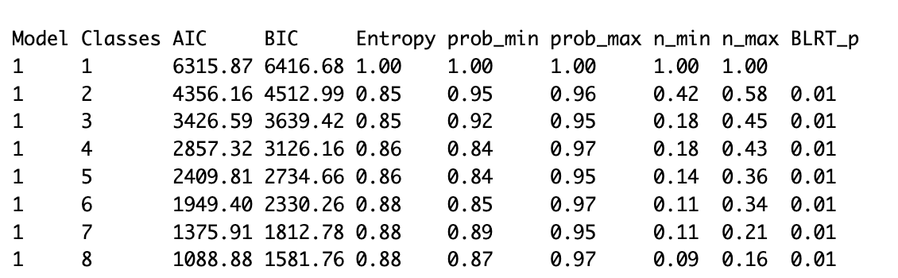
Significance and Application:
Insights into Diversity:
LPA provides insights into the underlying diversity within a population by identifying distinct subgroups with similar response patterns.
Unobservable Traits:
The method helps in uncovering unobservable traits or tendencies that contribute to the diversity observed in the dataset.
Versatile Tool:
LPA is a versatile tool applicable across various disciplines, offering a data-driven approach to understanding hidden structures within populations.

Slide 21
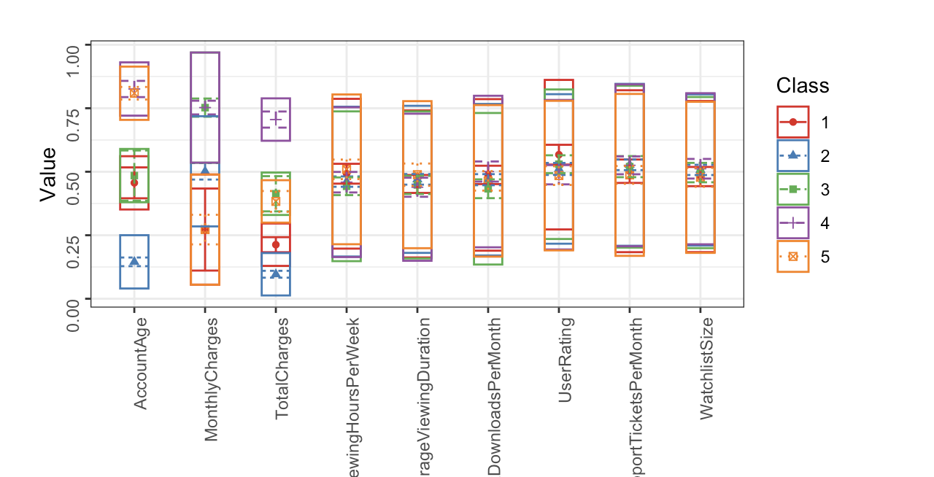

Slide 22
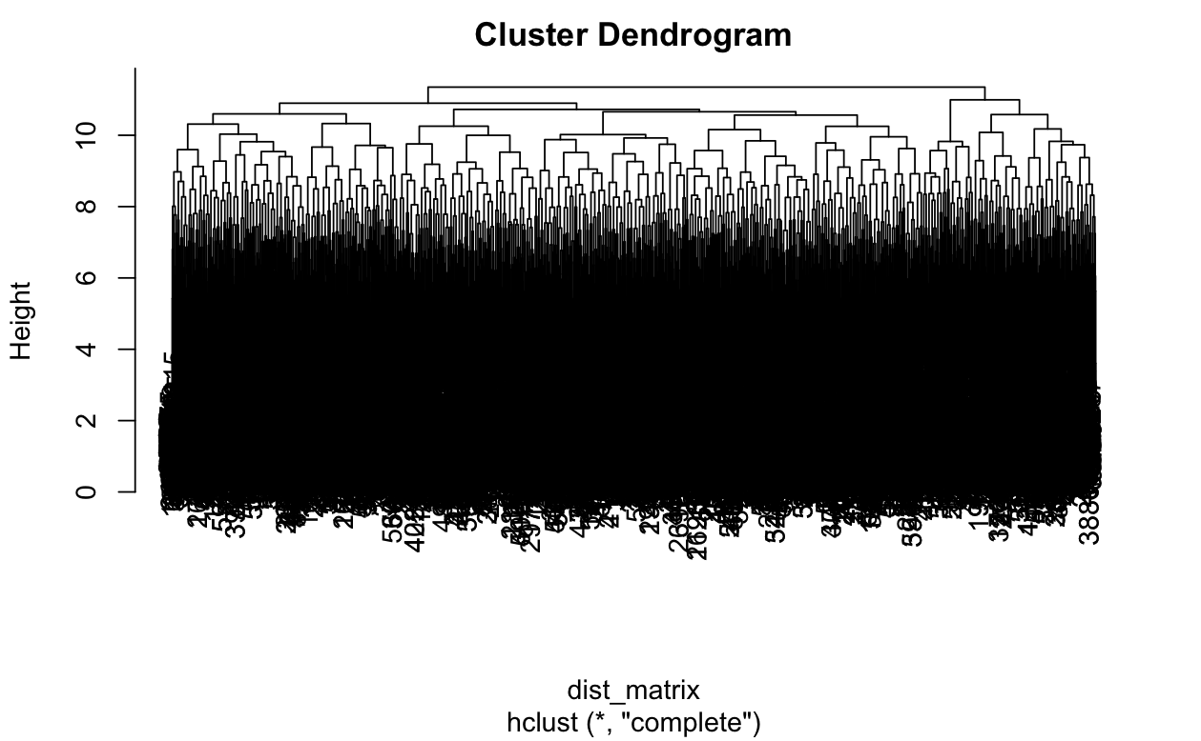
Hierarchical Clustering

Slide 23
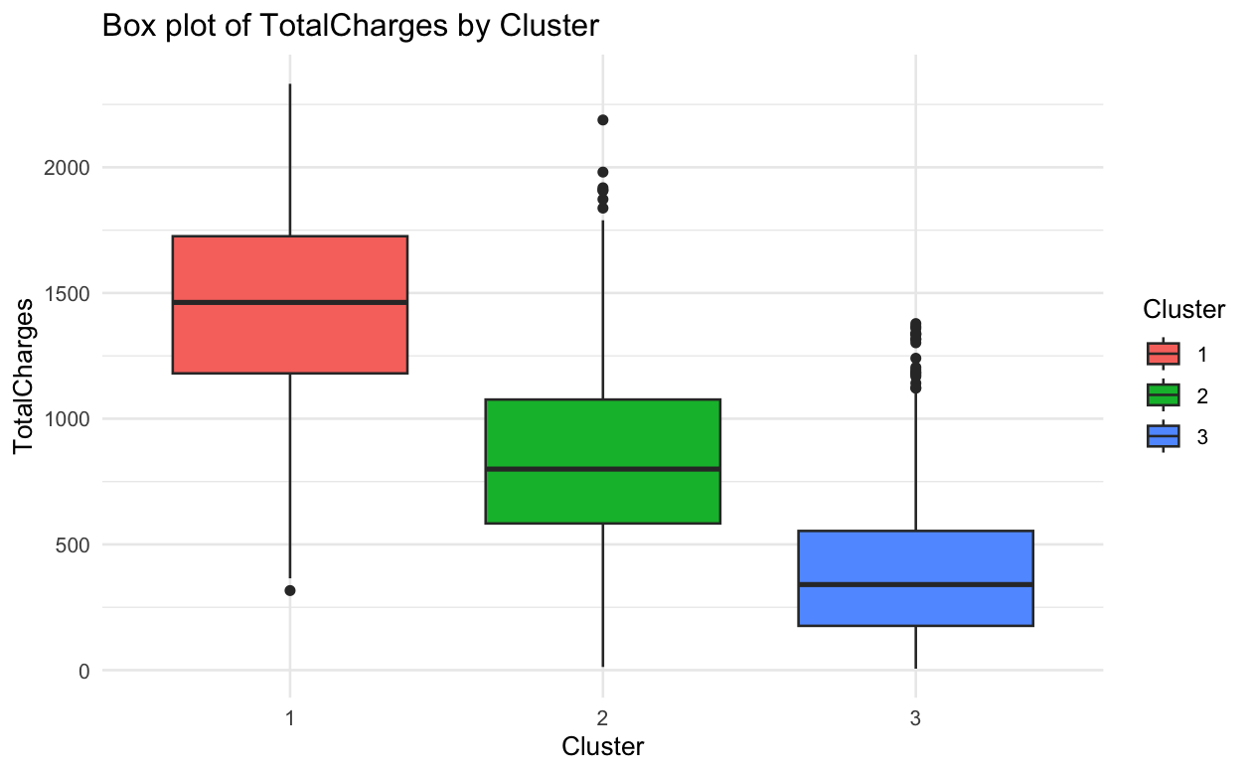
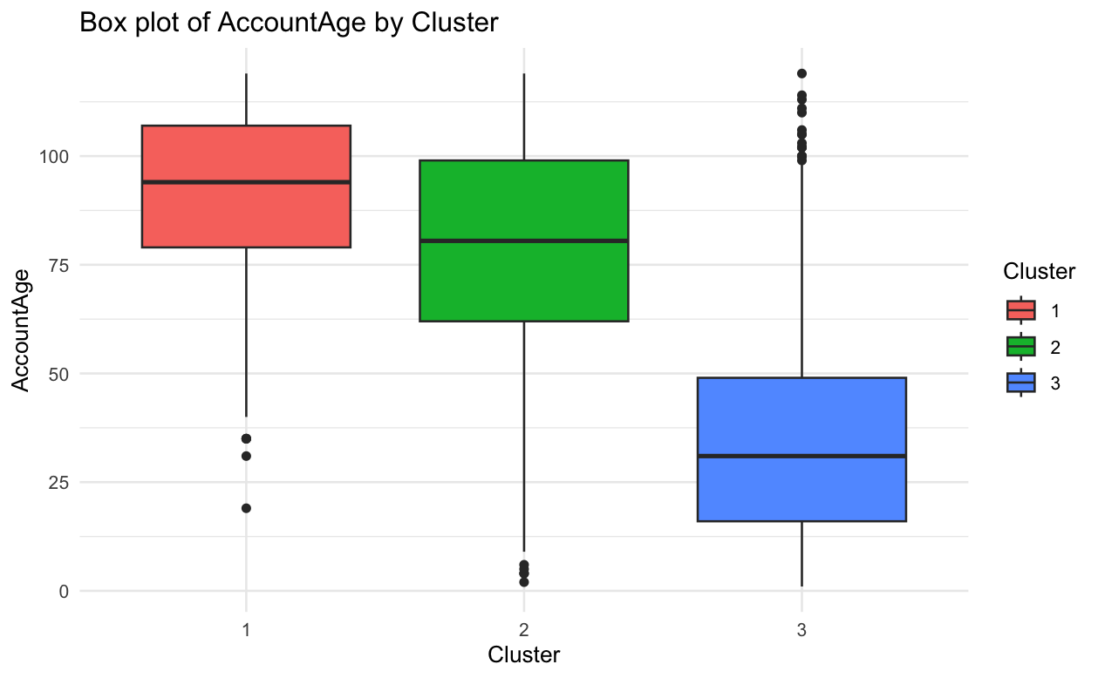
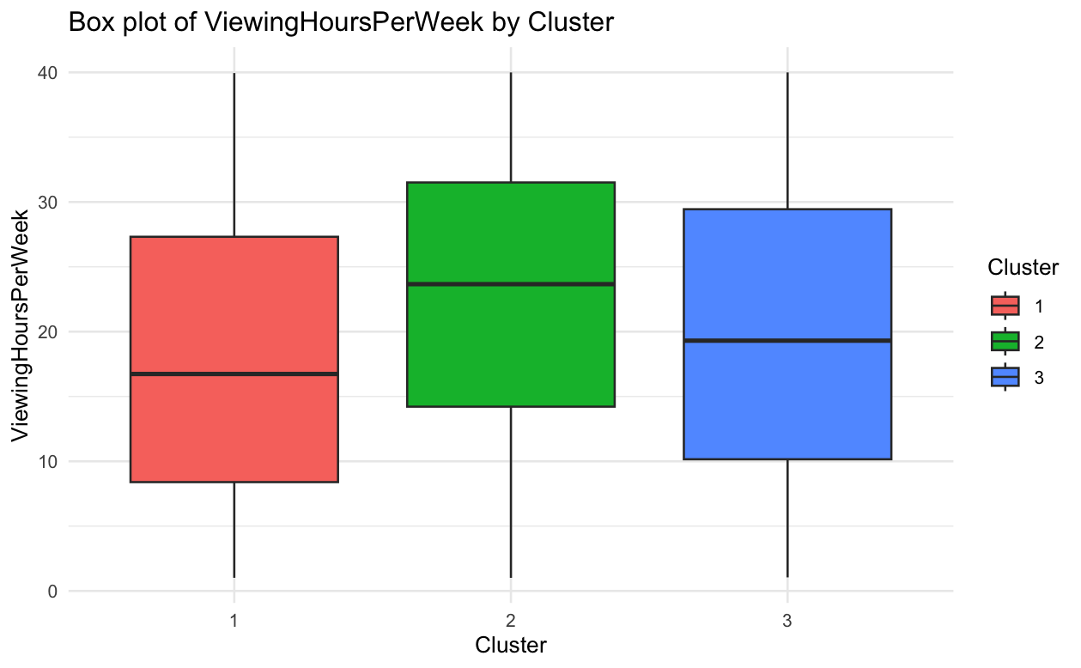
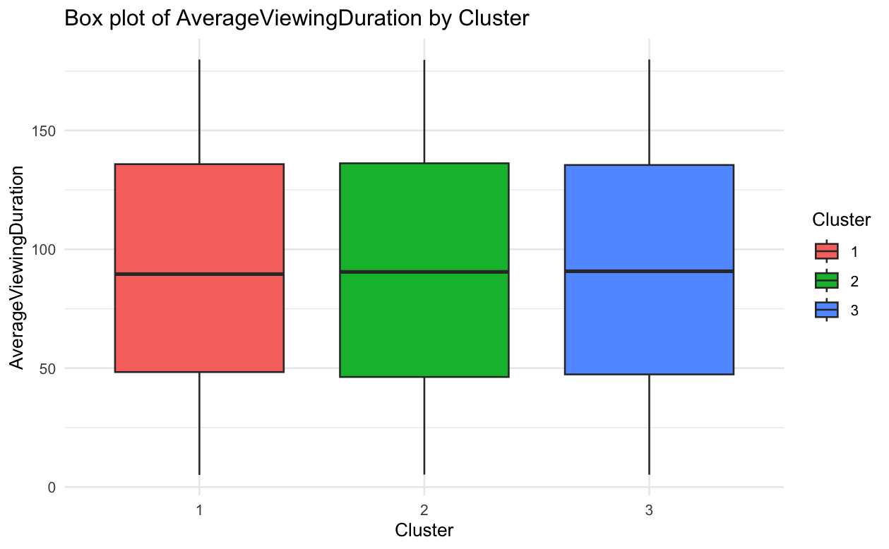
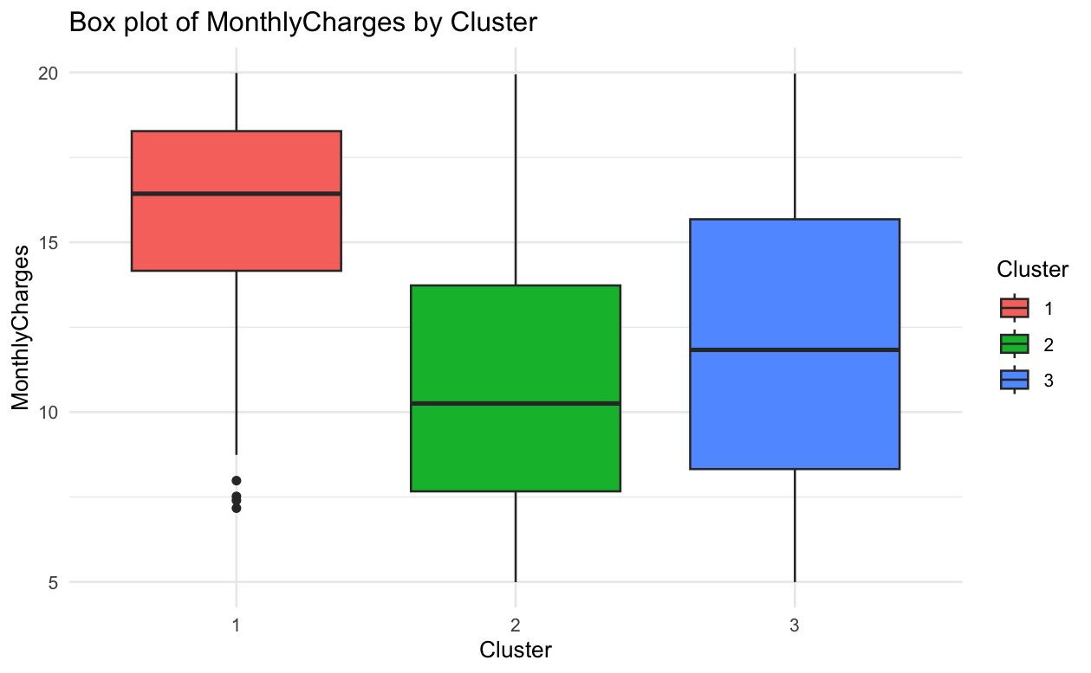

Slide 24
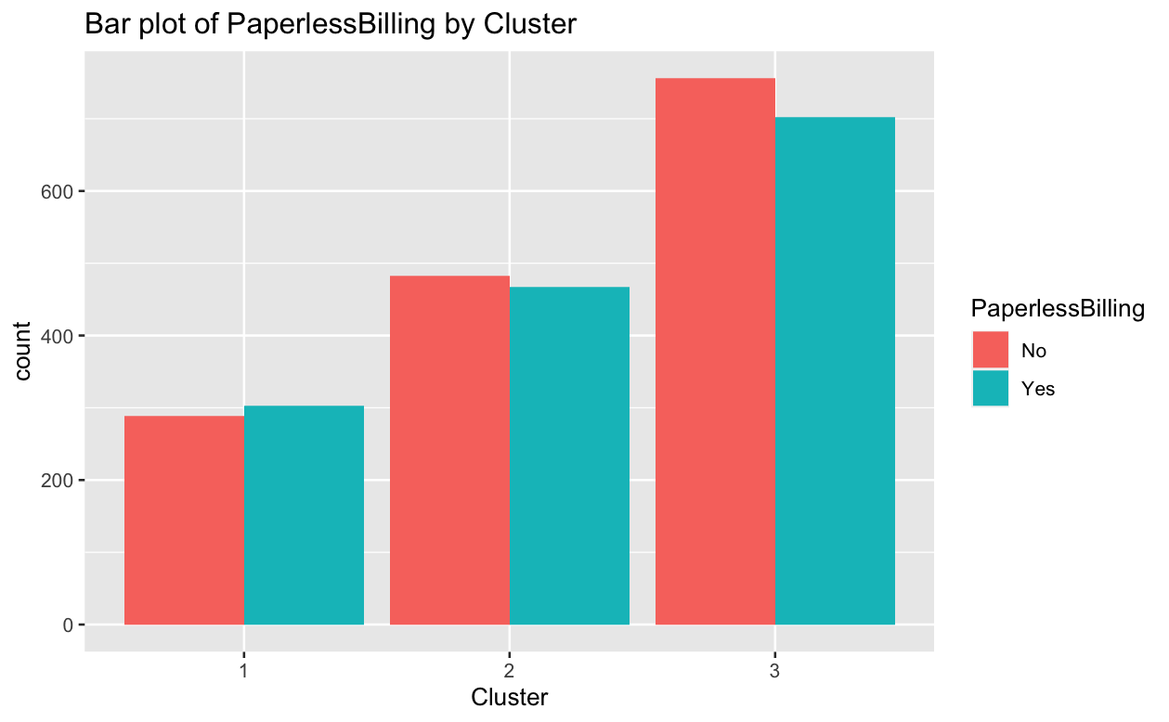
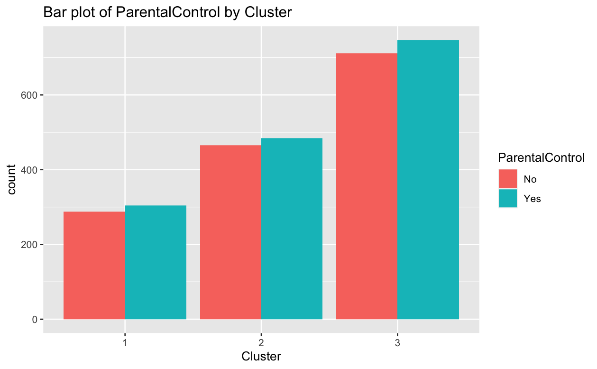
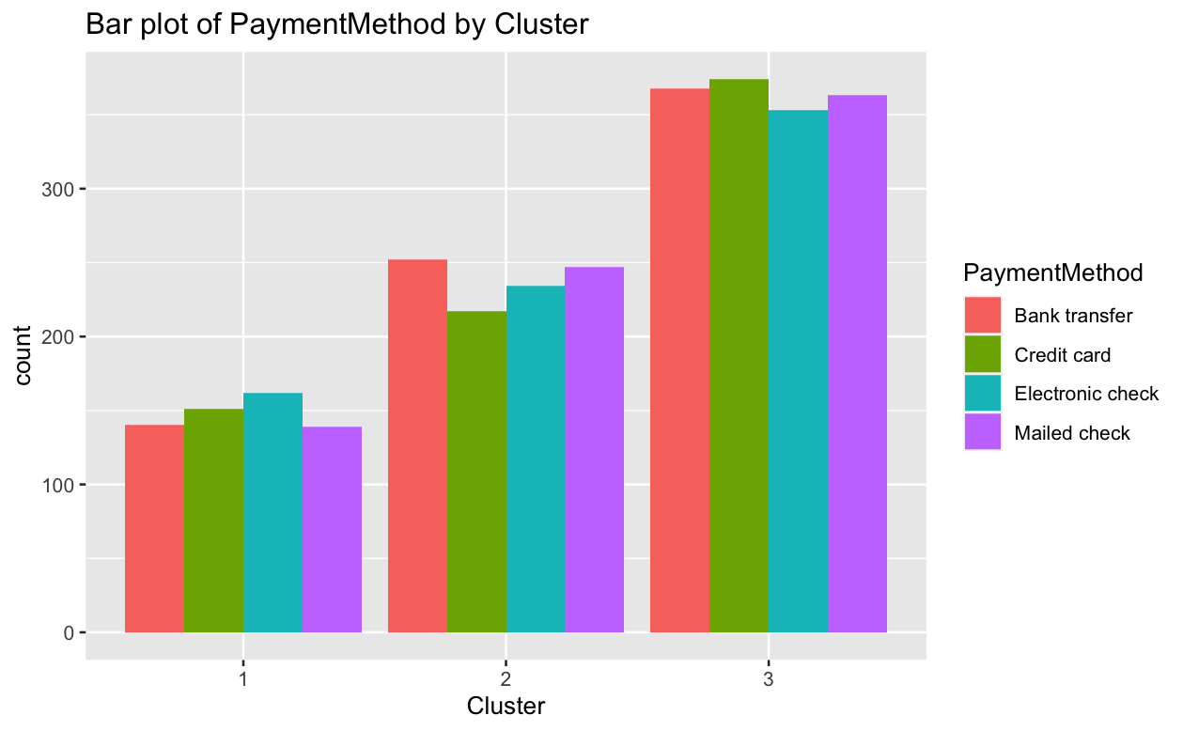
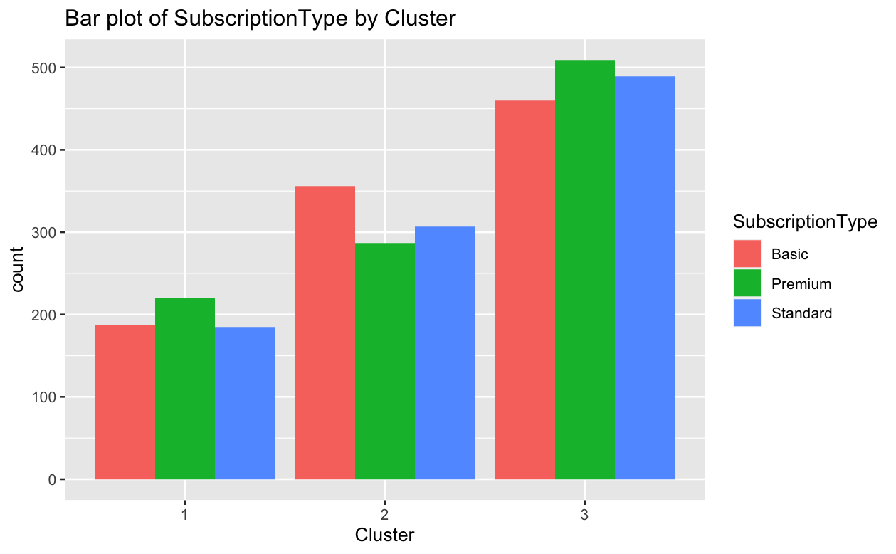
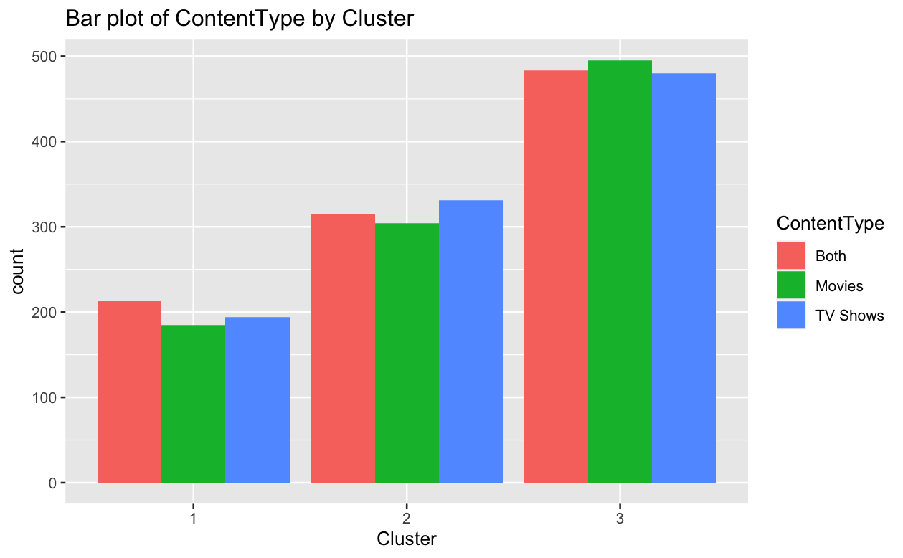

Slide 25
CONCLUSION:
Customer segmentation: We may split consumers into groups based on shared characteristics using cluster analysis. By analyzing the clusters, we may uncover several customer types with different interests, behaviors, and wants.
Patterns of Churn: Analyzing churn within each cluster reveals patterns and trends specific to each client type. For example, we may see that some clusters have a higher turnover rate than others. This knowledge is critical for identifying high-risk customers and developing targeted retention strategies.
Churn Drivers: By analyzing the characteristics and behaviors of customers within each cluster, we may identify aspects that contribute to churn. Certain clusters, for example, may have a higher turnover rate among consumers who have done fewer transactions or have lower levels of participation. Understanding these characteristics enables us to identify areas for improvement and take preventative measures to reduce Churn.
Using cluster analysis, we may adjust retention efforts to distinct client categories. Understanding the specific demands and preferences of each cluster allows us to build individualized methods to client retention. Loyalty programs or exclusive deals, for example, may benefit consumers in one cluster, whilst discounts or promotions may benefit customers in another.

Slide 26
THANK YOU

